Slide 1
DAB 203 Business Analysis and Decision Making FINAL PROJECT

Slide 2

Team Members
Ashok Sri Harsha Nettem-0781998
Asiff Shaik-0776149
Manikanth Syamala-0785751
ManishPreet kaur-0784729

Slide 3
Contents
Introduction
Problem Statement
What is Olist?
Data Description
Data Schema
Development Environment
Exploratory Data Analysis (EDA)
References
Conclusions
Table Structure

Slide 4
Introduction
This is a Final project for Business Analysis and Decision making course which depicts about visual analysis of datasets, problem identification, and problem solving. To begin, describe the Olist company and the datasets. Also, undertake EDA (exploratory data analysis) to gain a better understanding of how Olist works and to discover flaws. Finally, provide remedies to the problems as well as a cost-benefit analysis.

Slide 5
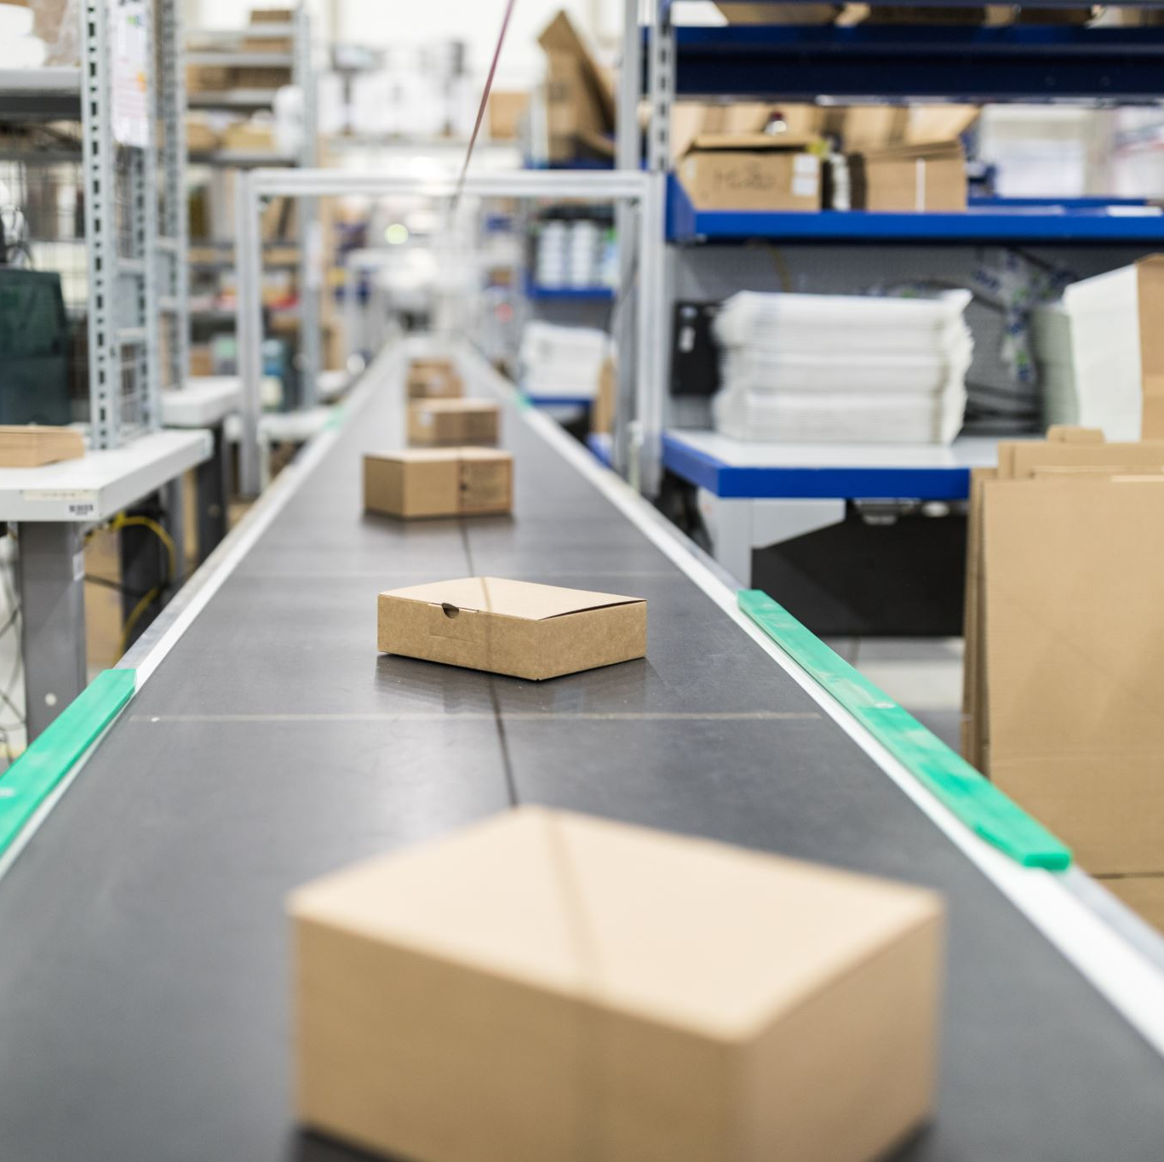
Problem Statement
Olist stores have an extremely low ratio of repeat consumers, implying that the majority of customers were one-time purchasers, and sales have dropped at times
The purpose of this project was to extensively examine the data, identify any issues, and provide insights, answers, and recommendations.
.

Slide 6
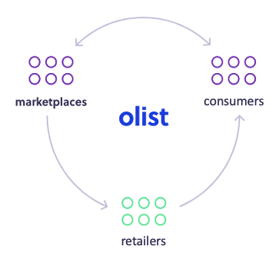
What is Olist?
Olist is a Brazilian department store that sells online, but since 2015 it has become a SaaS (Software as a Service) technology company. It provides retailers of all sizes with an e-commerce marketplace solution to help them grow their sales.
The Olist system has three components: software, contracts with major markets, and reputation sharing. The following diagram depicts how Olist connects markets, customers, and retailers.

Slide 7
Olist Dataset Description
This is a public Brazilian e-commerce dataset of Olist Store orders. From 2016 to 2018, the dataset contains information on 100k orders placed on several Brazilian marketplaces. Its capabilities allow you to evaluate an order from a variety of perspectives, including order status, pricing, payment, and freight performance, as well as customer location, product qualities, and customer feedback. A geolocation dataset relating Brazilian zip codes to latitudes/longitudes coordinates was also available.
The description of these entire tables is as follows:-
olist_orders_dataset : This table has four other tables attached to it. It's used to link all of an order's details together.
olist_order_items_dataset : It provides information about a purchased item, such as the shipment date, price, and so on.
olist_products_dataset : This dataset contains information about a product, such as its ID, category name, and dimensions.

Slide 8
Data Description
Olist_order_reviews_dataset: This dataset contains information about any reviews that a consumer has left on a product that he has purchased.
Olist_order_payments_dataset: This table contains information on the payment details linked with a certain order.
Olist_customers_dataset: This dataset contains information about this firm's customer base.
Olist_geolocation_dataset: This dataset contains geographical data about both sellers and customers.
Olist_sellers_dataset: This table holds information about all of the sellers who have signed up with this company.

Slide 9

Data Schema
The data is divided in multiple datasets for better understanding and organization.

Slide 10
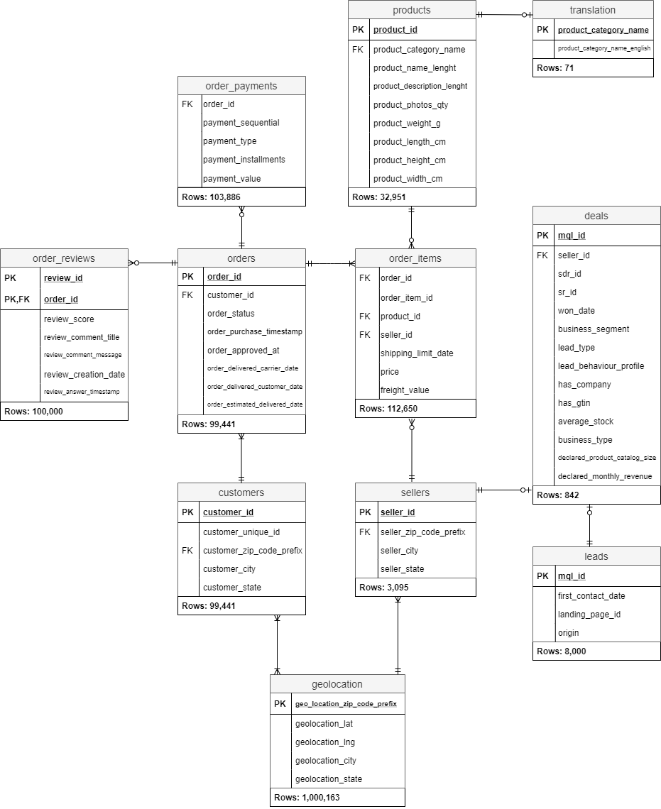
Table Structure

Slide 11
Development Environment
SQL Server
Tableau
Git hub Repository

Slide 12

Data Analysis

Slide 13
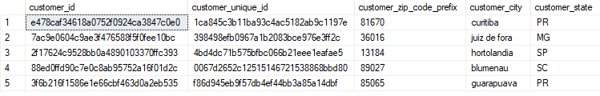
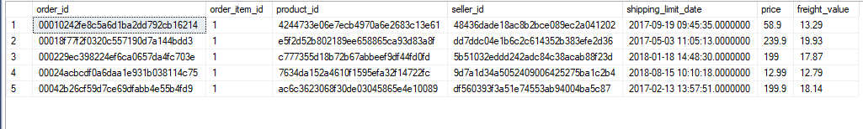
First five rows of olist customers data set
First Five row of olist order items dataset

Slide 14
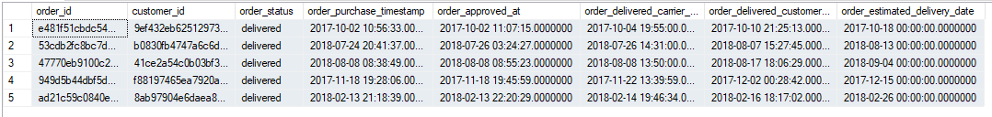
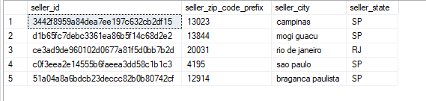
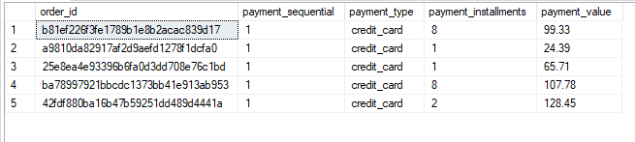
First Five rows of order items dataset
First five rows of sellers dataset
First five rows of order payments dataset

Slide 15
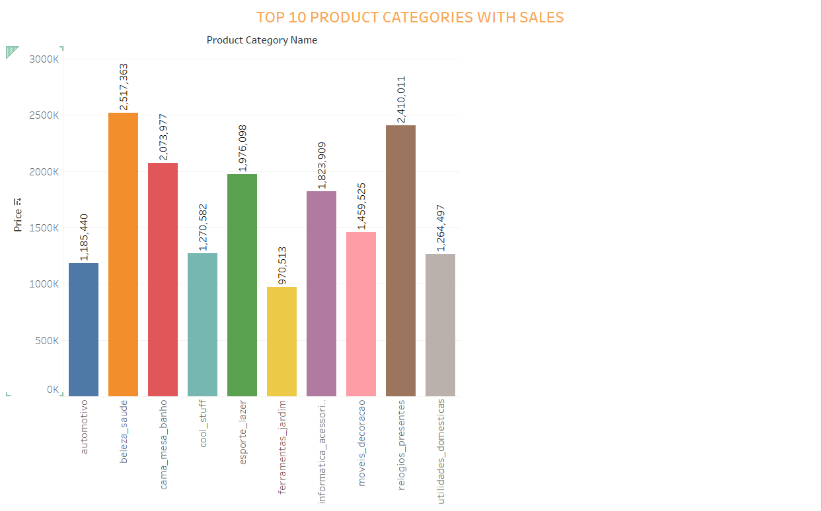
Top 10 sales product categories :- SELECT top 10 product_category_name, ROUND(SUM(price),2) AS price FROM olist_products_dataset pd INNER JOIN olist_order_items_dataset oit ON oit.product_id = pd.product_id GROUP BY product_category_name ORDER BY price DESC

Slide 16

Average delivery Time Interval:-
;WITH average_time AS
(
SELECT DATEDIFF ( DAY , order_purchase_timestamp , order_delivered_customer_date ) AS delivery_time
FROM olist_orders_dataset
WHERE order_status = 'delivered’
)SELECT AVG(delivery_time) AS "Average_Delivery_Time_Interval_(Estimated_vs_Actual)"
FROM average_time

Slide 17
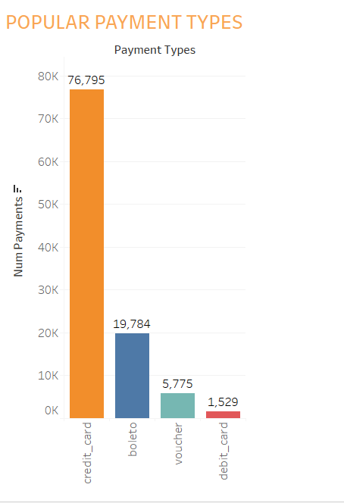
Popular payment types:- SELECT payment_type, COUNT(order_id) AS num_payments FROM olist_order_payments_dataset GROUP BY payment_type ORDER BY num_payments DESC;

Slide 18
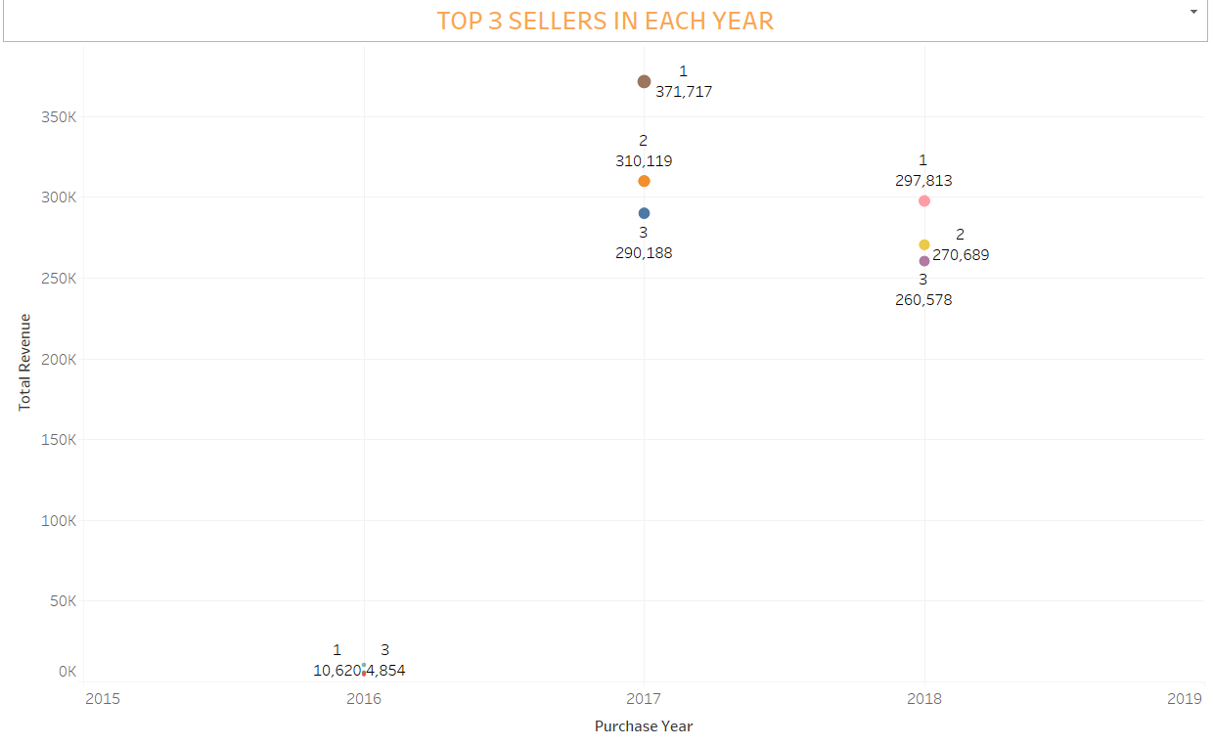
Top 3 Sellers in each year :-
SELECT purchase_year, seller_id, total_revenue, value_rank
FROM (SELECT purchase_year, seller_id,
SUM(t1.revenue) AS total_revenue,
RANK() OVER (PARTITION BY purchase_year ORDER BY SUM(t1.revenue) DESC)
AS value_rank
FROM (SELECT order_id, YEAR(order_purchase_timestamp) AS purchase_year
FROM olist_orders_dataset
WHERE order_status = 'delivered') o
JOIN (SELECT seller_id, order_id,
ROUND(SUM(price) + SUM(freight_value),2)
AS revenue
FROM olist_order_items_dataset
GROUP BY seller_id, order_id) t1
ON o.order_id = t1.order_id
GROUP BY purchase_year, seller_id) t2
WHERE value_rank IN (1,2,3);

Slide 19
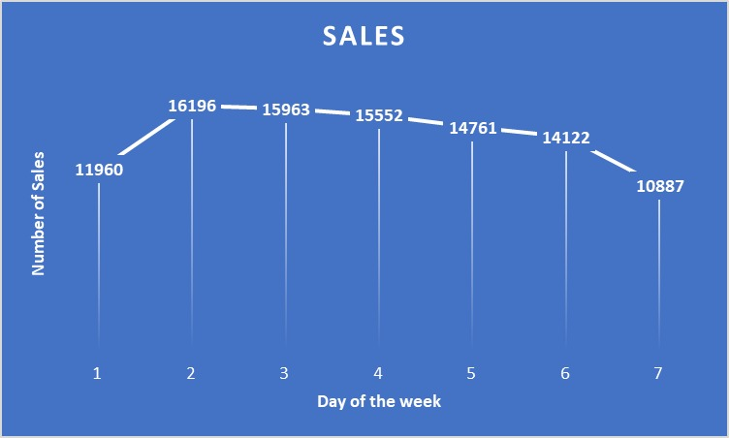
Daily sales of the Week:-
SELECT DATEPART(WEEKDAY, CONVERT(DATE, order_purchase_timestamp)) as day_of_week,
COUNT(order_id) AS sales
FROM olist_orders_dataset
GROUP BY DATEPART(WEEKDAY, CONVERT(DATE, order_purchase_timestamp))
order by day_of_week

Slide 20

How quickly does a consumer receive their order? The percentage of orders that arrive within 2 days, 1 week, 2 weeks, or more than 2 weeks after they are placed is calculated by query.
SELECT ROUND(CAST(SUM(case when DATEDIFF(day,CONVERT(DATE, o.order_purchase_timestamp),CONVERT(DATE, o.order_delivered_customer_date)) < = 2 then 1 else 0 end) as float)/CAST(COUNT(o.order_id) as float)*100,2)
AS under_two_days,
ROUND(CAST(SUM(case when DATEDIFF(day,CONVERT(DATE, o.order_purchase_timestamp),
CONVERT(DATE, o.order_delivered_customer_date)) BETWEEN 3 AND 5 then 1 else 0 end) as float)/CAST(COUNT(o.order_id) as float)*100,2)
AS in_one_week,
ROUND(CAST(SUM(case when DATEDIFF(day,CONVERT(DATE, o.order_purchase_timestamp),
CONVERT(DATE, o.order_delivered_customer_date)) BETWEEN 6 AND 14 then 1 else 0 end) as float)/CAST(COUNT(o.order_id) as float)*100,2)
AS in_two_weeks,
ROUND(CAST(SUM(case when DATEDIFF(day,CONVERT(DATE, o.order_purchase_timestamp),
CONVERT(DATE, o.order_delivered_customer_date)) > 14 then 1 else 0 end) as float)/CAST(COUNT(o.order_id) as float)*100,2)
AS more_than_two_weeks
from olist_orders_dataset o
WHERE o.order_status = 'delivered'
AND CONVERT(varchar,o.order_delivered_customer_date) != '0000-00-00 00:00:00'
AND DATEDIFF(day,CONVERT(DATE, o.order_purchase_timestamp),CONVERT(DATE, o.order_delivered_customer_date)) >= 0;

Slide 21
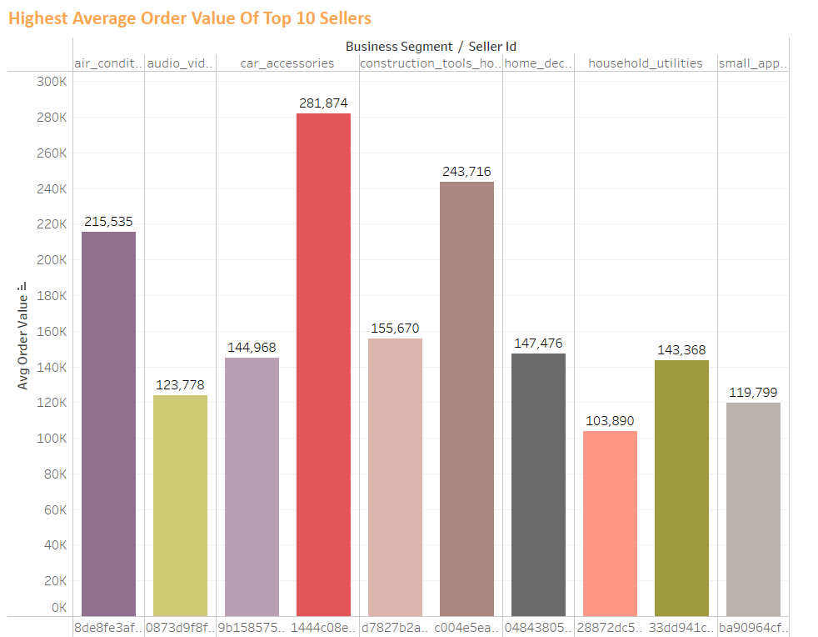
Highest average order value of top 10 sellers:-
SELECT top 10 t1.seller_id, business_segment,
ROUND(cast(total_order_value as float)/cast(num_orders as float)*100,2)
AS avg_order_value
FROM (SELECT seller_id,
COUNT(DISTINCT order_id)
AS num_orders,
SUM(price) + SUM(freight_value)
AS total_order_value
FROM olist_order_items_dataset
GROUP BY seller_id) t1
JOIN olist_closed_deals_dataset d
ON t1.seller_id = d.seller_id
ORDER BY avg_order_value DESC;

Slide 22
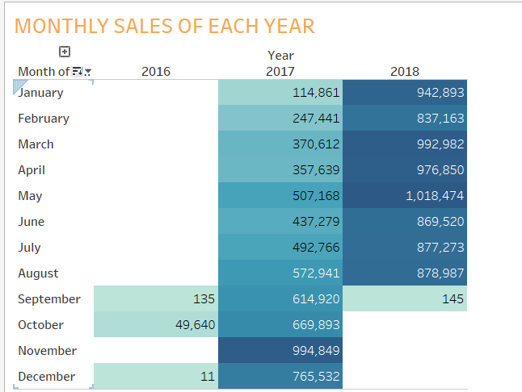
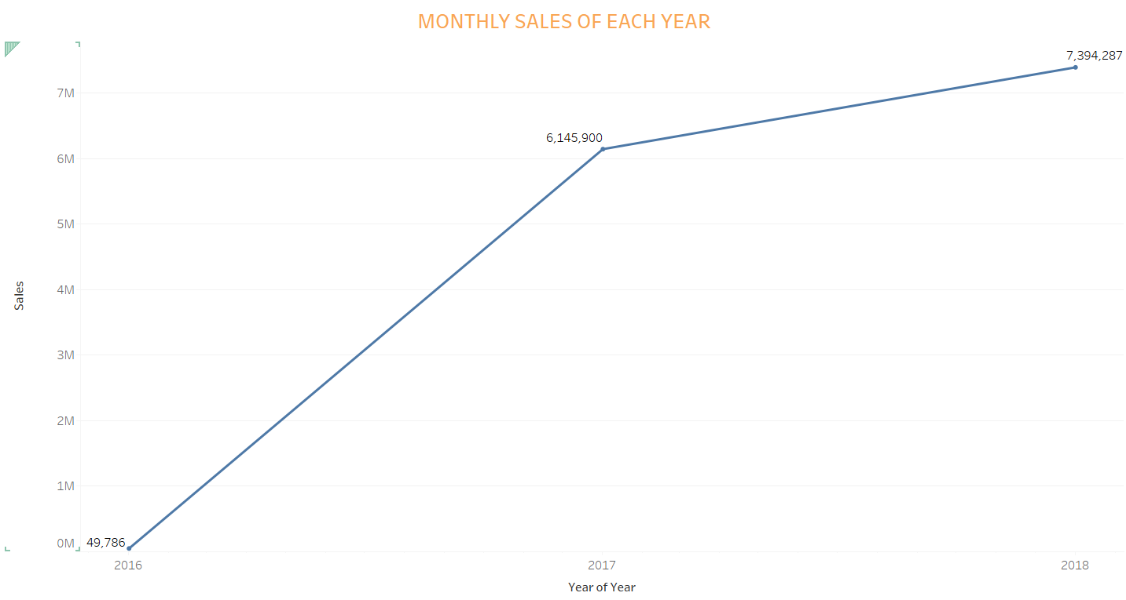
SALES BY TIME IN Olist( 2016- 2018):-
SELECT DATEPART(MONTH, a.order_approved_at) AS MONTH,
DATEPART(YEAR, a.order_approved_at) AS YEAR,
SUM(b.price) AS SALES
FROM olist_orders_dataset AS a
INNER JOIN olist_order_items_dataset AS b
ON a.order_id = b.order_id
GROUP BY DATEPART(MONTH, a.order_approved_at),
DATEPART(YEAR, a.order_approved_at)
ORDER BY DATEPART(YEAR, a.order_approved_at),
DATEPART(MONTH, a.order_approved_at)

Slide 23
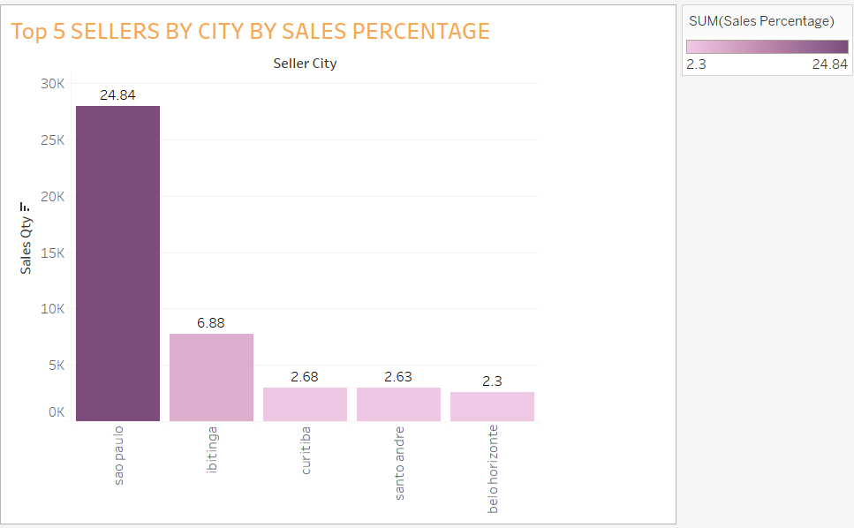
TOP 5 Selling cities based on sales:-
;WITH temp_sellers AS (
SELECT a.seller_city AS seller_city,
COUNT(b.order_id) AS sales_qty,
COUNT(b.order_id) * 100.0 /
SUM(COUNT(b.order_id)) OVER () AS temp_sales_percentage
FROM olist_sellers_dataset AS a
INNER JOIN olist_order_items_dataset AS b
ON a.seller_id = b.seller_id
GROUP BY seller_city
ORDER BY sales_qty DESC
) SELECT top 5 seller_city,
sales_qty,
temp_sales_percentage AS sales_percentage FROM temp_sellers

Slide 24
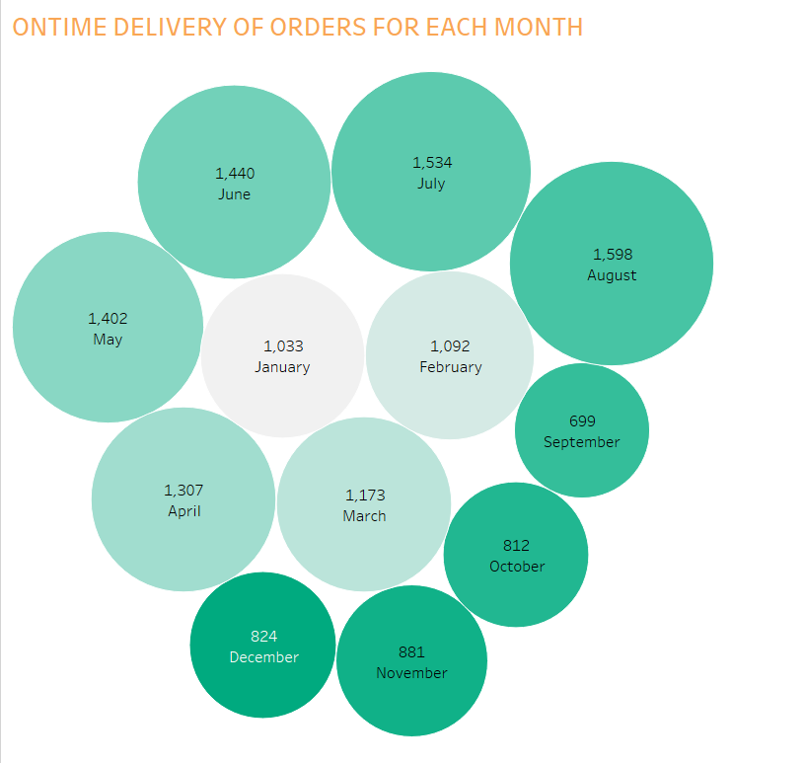
Ontime delivery rate of each month for respective years:-
SELECT MONTH(order_purchase_timestamp) AS pusrchase_month,
COUNT(DISTINCT seller_id) AS num_sellers
FROM (SELECT oi.seller_id, o.order_purchase_timestamp
FROM olist_orders_dataset o JOIN olist_order_items_dataset oi
ON o.order_id = oi.order_id
WHERE order_status = 'delivered'
AND CONVERT(varchar,o.order_delivered_customer_date) != '0000-00-00 00:00:00’
AND DATEDIFF(day,CONVERT(DATE, o.order_delivered_customer_date),
CONVERT(DATE, o.order_estimated_delivery_date)) >= 0
) a
GROUP BY MONTH(order_purchase_timestamp)
ORDER BY MONTH(order_purchase_timestamp);

Slide 25
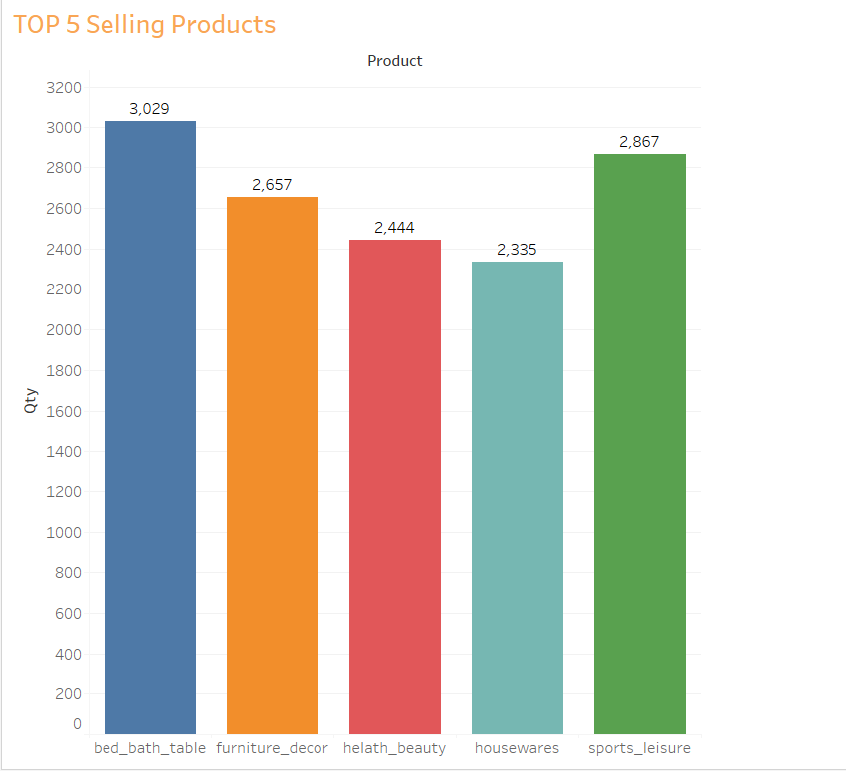
Top 5 Selling products in olist:-
SELECT Top 5 a.product_category_name_english AS product,
COUNT(b.product_category_name) AS qty
FROM product_category_name_translation AS a
INNER JOIN olist_products_dataset AS b
ON a.product_category_name = b.product_category_name
GROUP BY product
ORDER BY qty DESC

Slide 26
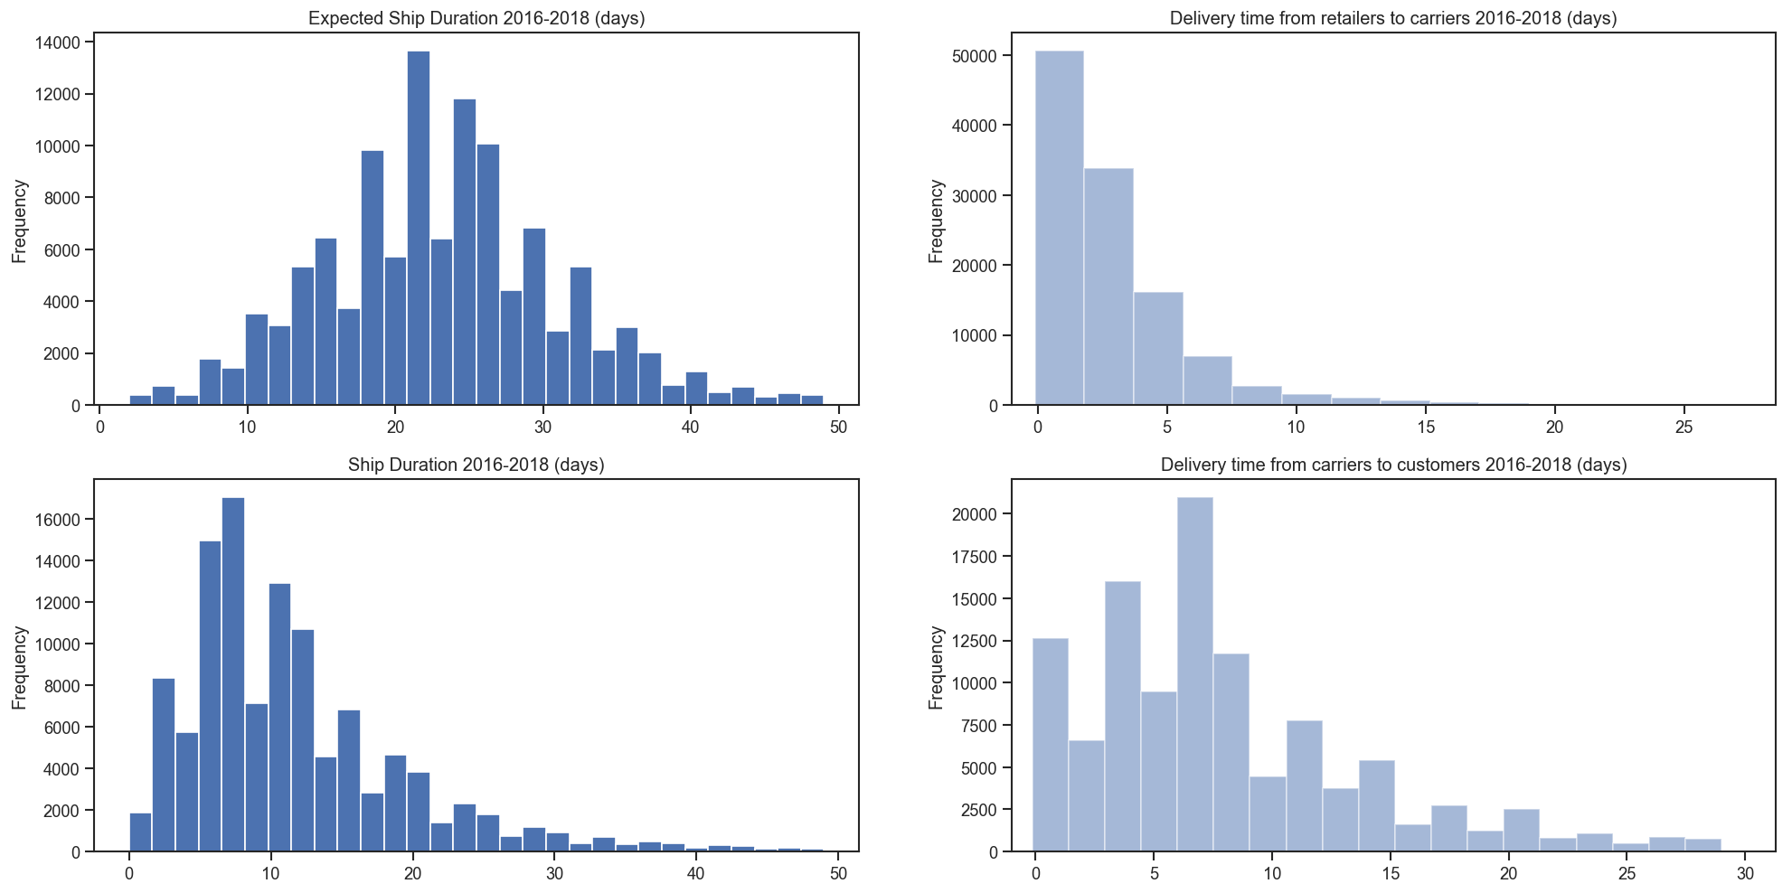
The top cities with the most orders and sales had the shortest average delivery times, implying that delivery time is a big factor in customer attrition. We may deduce from the graphs above that the delivery performance isn't fantastic, and this needs to be investigated.

Slide 27
Conclusion
Brazil is the 14th largest e-commerce market in the world, with revenues of $21 billion in 2020. With a population of 210 million people, the market is huge. Brazil According to the World Bank, it has the tenth largest economy in the world, with a GDP of $1.84 trillion information (Azevedo, 2021). Most countries have been touched by the pandemic, and As a result, people are increasingly turning to internet purchasing instead of making a purchase at a market. JPMorgan's e-commerce payment plan for 2020According to statistics, Brazil's e-commerce market has been rising at a rapid pace.Since 2017, it has grown at double-digit rates, and it is expected to increase at a pace of more than 9% per year in the future. Through 2023, owing to COVID-19's economic pressures (Moeser,2021).
Future research in this area could include figuring out how the links discovered inThis research could be used to boost income in other e-commerce businesses in Brazil.

Slide 28
References:
https://www.kaggle.com/olistbr/brazilian-ecommerce
https://towardsdatascience.com/case-study-1-customer-satisfaction-prediction-on-olist-brazillian-dataset-4289bdd20076
https://owenhsu94.medium.com/analysis-of-brazilian-e-commerce-datasets-olist-a33e38f677ea

